Slide 1
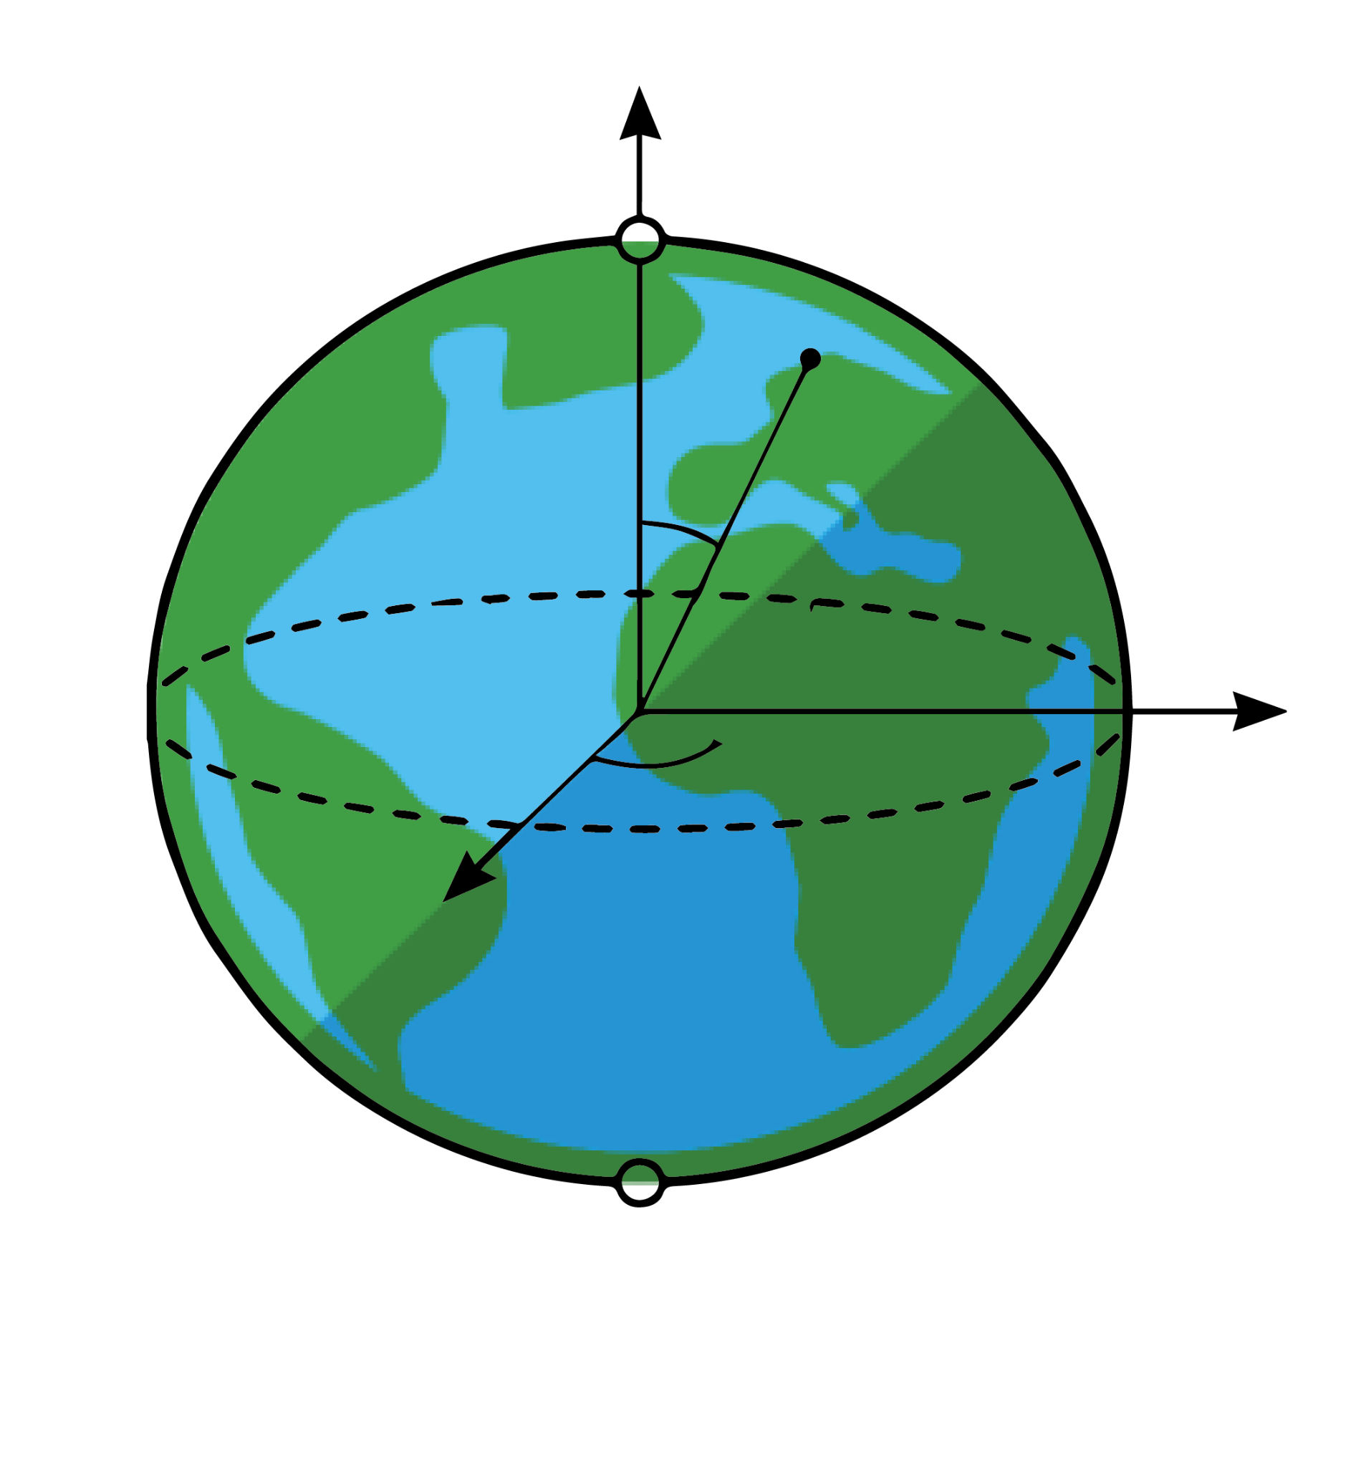
QubitSat
Notes:
Clear + concise description of what this is about (e.g. 30s elevator pitch)vator pitch)

Slide 2
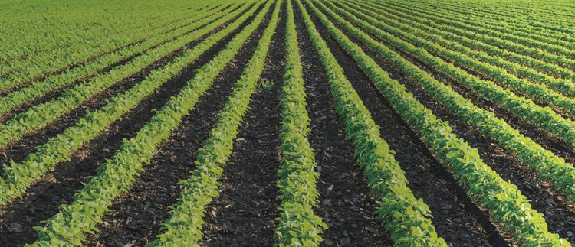
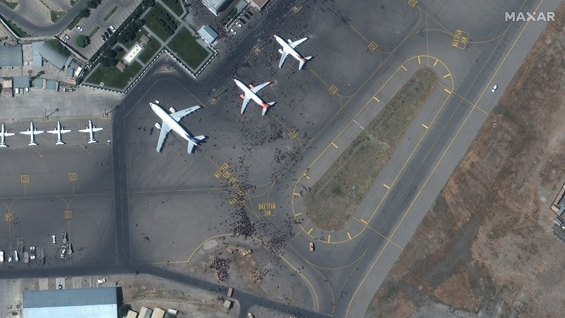
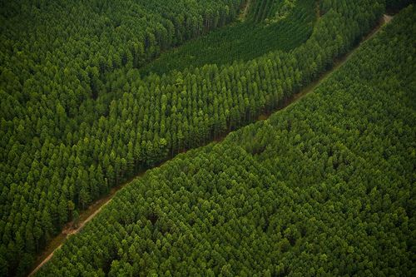
Problem - A constant need for higher resolution imagery
Earth Data is Mission Critical...
...but limited by current sensors
Saving season’s crop yield after detecting early signs of infestation
Without accurate data
Agriculture companies lose revenue and competitive advantage
1999
Ikonos (DigitalGlobe) : 1m - 4m
2000
EROS A (ImageSat) : 1.8m
2001
QuickBird (DigitalGlobe) : 0.6m - 2m
Maintaining situational awareness after detecting a plane departure from a location of interest
Without accurate data
Government lack situational awareness - risking national security and citizen safety
2006
EROS B (ImageSat) : 0.7m
2008
RapidEye (Planet) : 5m
GeoEye 1 (Maxar) : 0.41m - 1.65m
2009
WorldView 2 (Maxar) : 0.46m - 1.8m
Monitor resources by tracking deforestation, causing up to 20% of Greenhouse Gas emission
Without accurate data
Companies lack information to report ESG metrics - excluding them from key investor portfolios
2012
Pléiades (Airbus) : 0.5m - 2m
SkySat (Planet) : 0.5m - 2m
WorldView 3 (Maxar) : 0.3m - 1.2m
2014
Notes:
- Problem clearly + concisely stated
- Critical pain point: people are actively looking for a solution

Slide 3
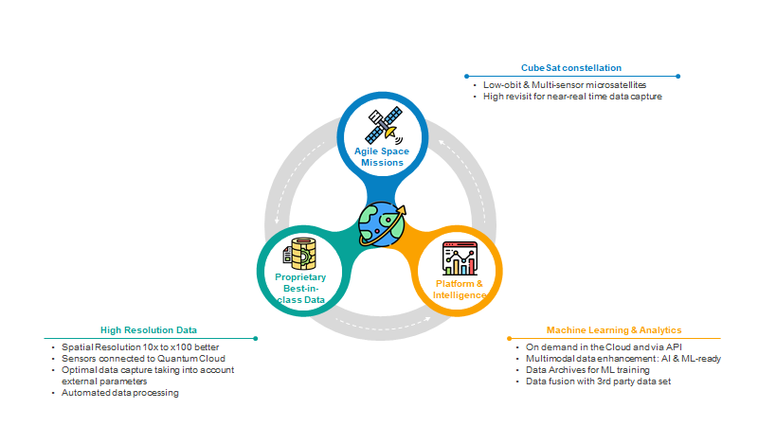
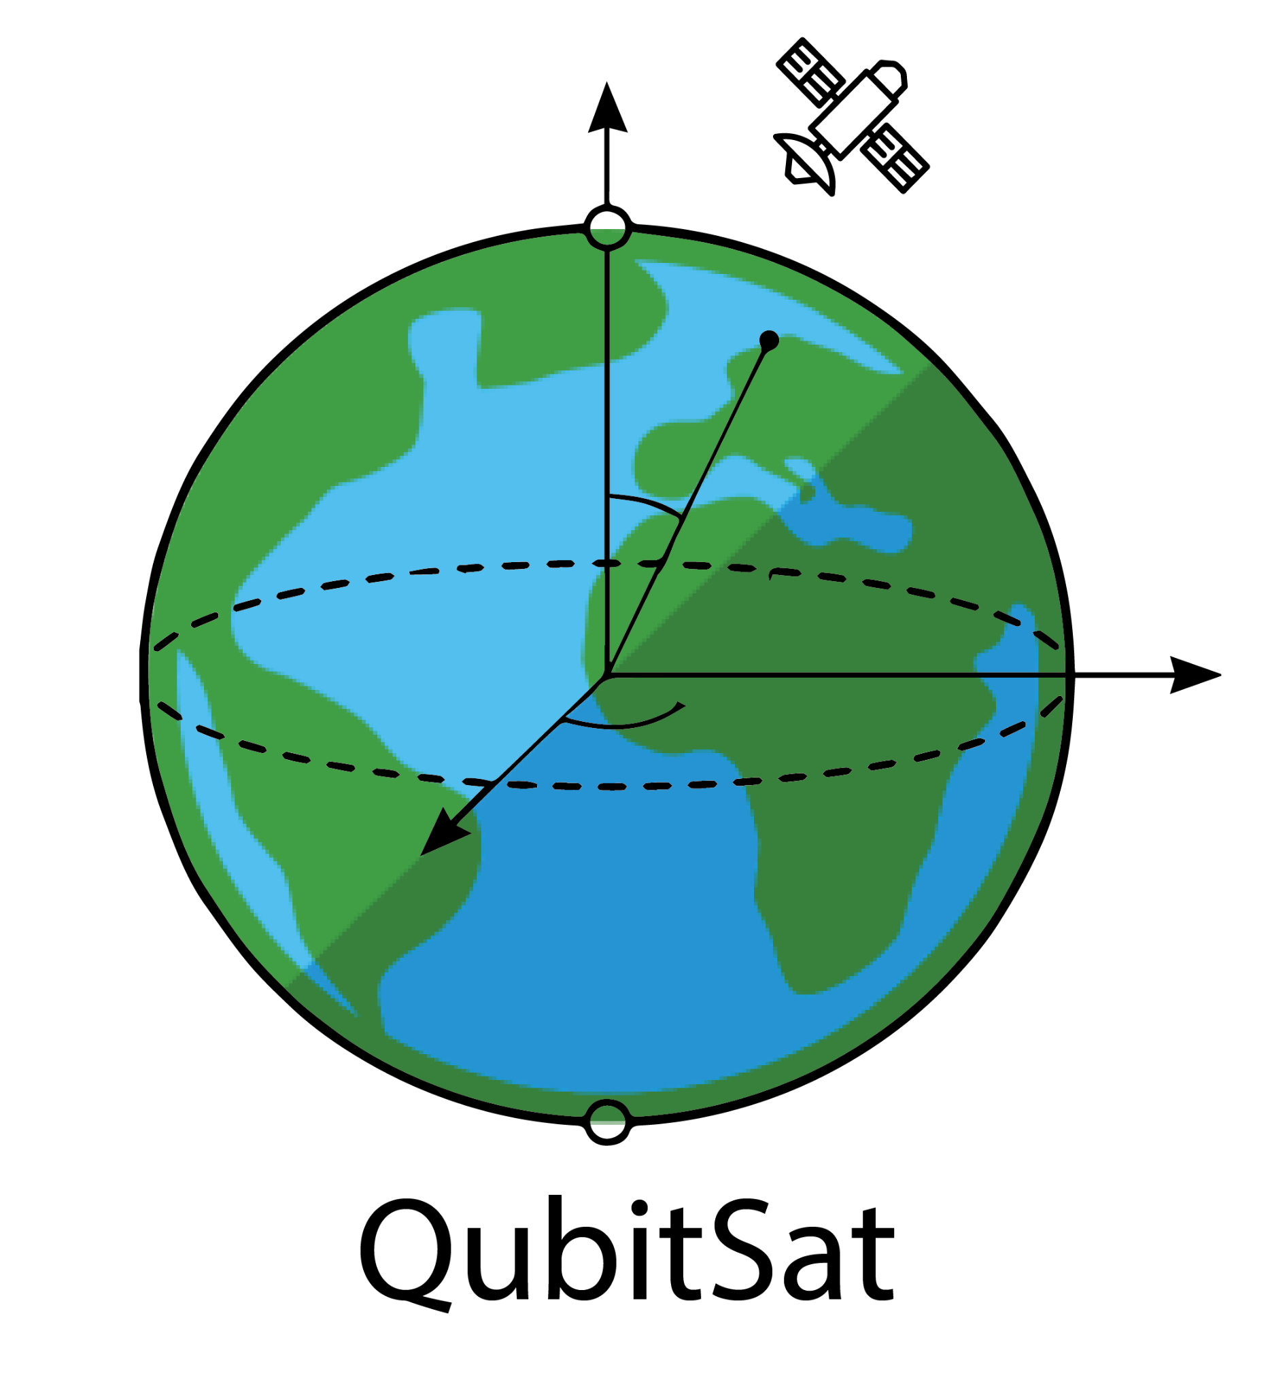
Solution - Leveraging Quantum Approach to improve Earth Data and deliver high value in one platform
Notes:
- Problem clearly + concisely stated
- Critical pain point: people are actively looking for a solution

Slide 4
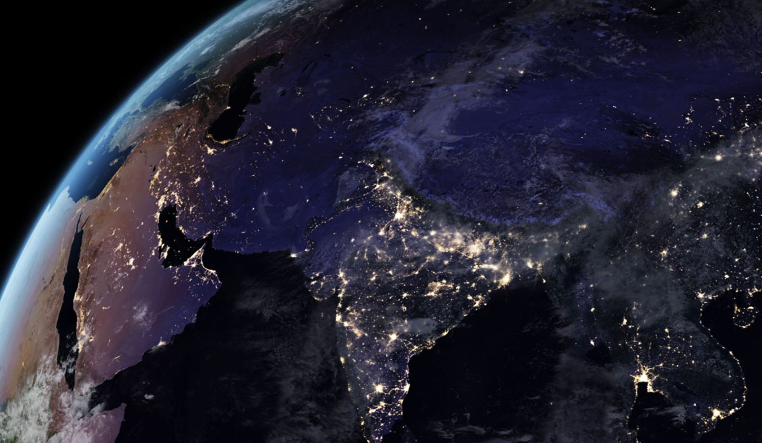
Technology has unveiled a multi-billion market opportunity
Notes:
- Coherent + reasonable market estimation
- Market is large >$1Bn + growing
- Market breakdown, segments, show knowledge of the market (obstacles, regulations…)

Slide 5
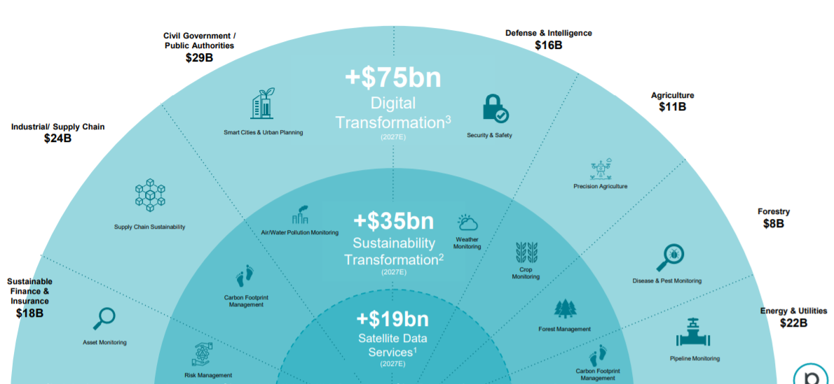
Market - Global Picture
Notes:
- Coherent + reasonable market estimation
- Market is large >$1Bn + growing
- Market breakdown, segments, show knowledge of the market (obstacles, regulations…)

Slide 6
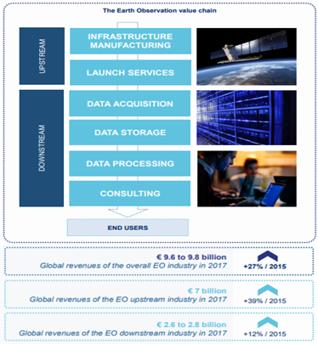
The target is the Earth Observation downstream Market
The raw data cannot be exploited directly because it is generally the information contained in the images that is of value. Earth observation data alone does not add value, but creates it through the applications that derive from it. The role of intermediate users, as the interface between the technical characteristics of the satellite and the specific needs of end users, is crucial in the Earth observation value chain.
Notes:
Upstream of the value chain, there are the players in the space industry in charge of the development and manufacture of space infrastructures (satellites), their operation (mission control and payload management) as well as the operations of launch.
Downstream, there are companies and institutional actors whose activities revolve around the processing of OT data and the creation of Value Added Services (VAS) based on this data. These actors tend to be EO experts and can be seen as “middle users” of the data.
End-users are made up of companies and institutional actors for whom the TO derivatives are inputs, but whose main activity is not centered on the TO. These end users are not experts in these technologies and therefore generally rely on intermediate users to gain access to products relevant to their business.

Slide 7
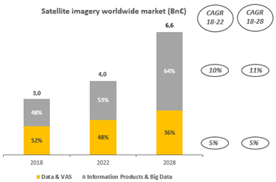
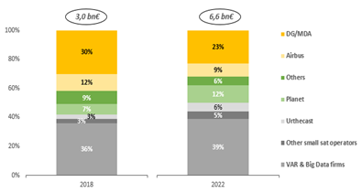
A “downstream” market of more than € 3Bn in 2019 with a CAGR of 7% expected between 2018 and 2022, driven by the multiplication of use cases
Downstream Market
Worldwide market shares
Big Data companies and VAR companies are expected to gain more market shares in the future (39% in 2022)
By 2022, the market should reach 4.0 billion euros, driven by Data Analytics (+ 60%).
Notes:
Traditionally segmented between Data Providers / VAS (Value Added Services) and Data Analytics (Information Products and Big Data), the satellite imagery market was estimated at around 3 billion euros in 2018.
VAS continues to slow down as processes are internalized by data providers (upstream actors like satellite operators who seek downstream value by reaching the entire value chain) and IP / Big applications Data (downstream players like Kayrros who are looking for efficiency and automation).
By 2022, the market should reach 4.0 billion euros, driven by Data Analytics (+ 60%).
Historical market leaders such as Maxar / DigitalGlobe or Airbus are faced with increasing competition from new entrants who differentiate themselves on the added value of their analyzes.
Big Data companies and VAR companies are expected to gain more market share in the future (39% in 2022)

Slide 8
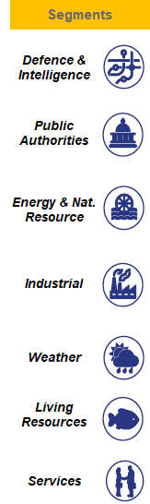
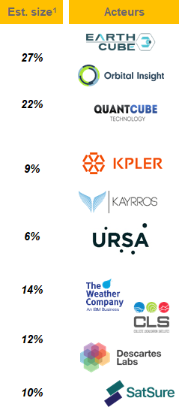
The global market is primarily driven by government applications, but resource verticals are increasingly demanding Earth Observation services
Military and strategic surveillance, tactical organization of theaters of operations, surveillance of assets on the ground.
Surveillance, infrastructure mapping, crop yield monitoring, land use assessment, monitoring of scarce resources.
All stages from exploration to dismantling (including construction and remediation): oil exploration, mining exploration, preparation of responses to oil spills, crisis management, monitoring of soil erosion, optimization of renewable energy production.
Monitoring of industrial assets (telecom infrastructure), shipping routes, utilities, performance (competitive intelligence), cellular network coverage / IoT solutions.
Commercial weather data enabling risk management for aviation, transportation, agriculture, etc.
Mapping, crop yield monitoring, irrigation optimization, land use assessment, scarce resource monitoring, fishing and aquaculture.
Commercial mapping for urban mobility, risk management based on geo-information services for the financial sector, smart contracts compatible with insurance.

Slide 9
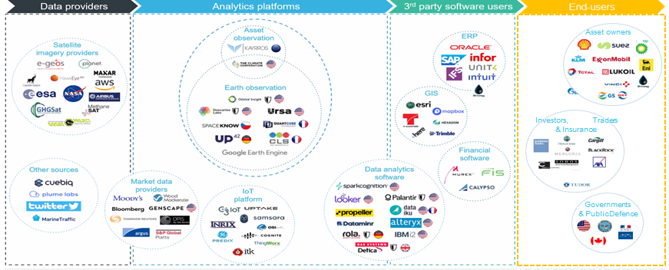
Competition : The players in the geospatial data analysis market
Notes:
Assess competitive risk + explain why team is better equipped than competitors to be the leader
Value chain + compétition

Slide 10




Direct Competitors
QubitSat
Constellation
✔️
✔️
❌
❌
✔️
✔️
Low Data Price
❌
✔️
✔️
✔️
✔️
❌
Defense
✔️
✔️
✔️
✔️
✔️
✔️
Climate change risk
✔️
✔️
✔️
❌
✔️
❌
Quantum technology
✔️
❌
❌
❌
❌
❌

Slide 11



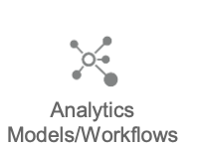
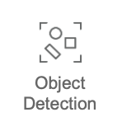
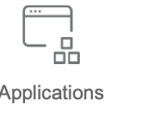
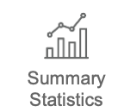
Conquering the market: one vertical at a time
SD : je passe sur pouwerpouent
A Safer world
Early adopters
Focus on defense
Address tomorrow’s challenge
Next-gen actors
Climate
AgTech
Population
Expand
Other verticals
To address directly or via canals
CubitSat platform

Slide 12
A clear path to growth
SD : je passe sur pouwerpouent
Business Model
Go-To-Market
Subscription Model with Long-Term multi-year contracts
SLA requirements
Highly Diversified and Differentiated Revenue Base
Notes:
- Distribution channels + sales strategy
- Business model is simple + clear
- Cost structure (e.g. client acquisition cost…) + profit allocation
- Business model is scaling + ability to generate cash flows (including metrics if relevant: e.g. lifetime client value…)

Slide 13
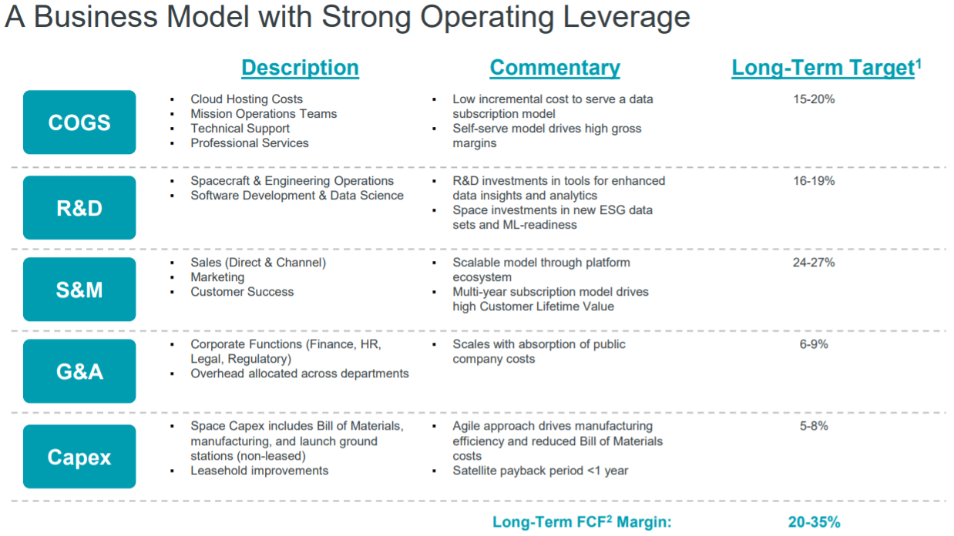
A clear path to growth
SD : je passe sur pouwerpouent
Notes:
- Distribution channels + sales strategy
- Business model is simple + clear
- Cost structure (e.g. client acquisition cost…) + profit allocation
- Business model is scaling + ability to generate cash flows (including metrics if relevant: e.g. lifetime client value…)

Slide 14

Sustainability
We can help you tackle complex sustainability challenges that balance economic growth, social well-being, and ecological stewardship.
AGRICULTURE
Our global, high frequency data can be instrumental in measuring the efficacy of sustainable agriculture practices as well as identifying potential food security risks across the globe.
ENERGY AND INFRASTRUCTURE
Climate risks pose serious threats to aging energy grids and infrastructure. Our data can help monitor encroachment and manage vegetation in the context of more frequent extreme weather events.
GOVERNMENT
Public-private partnerships are critical for building the technologies and designing policies that measure and verify sustainability efforts.
EX : Satellite Data to support the European Green Deal
Notes:
With a growing global population, responding to the linked challenges of sustainable development, loss of biological diversity, and climate change is critical. For humanity to prosper, we must transition to practices that operate within the limits of Earth’s life-support systems. We have entered a critical decade of action. Whether you’re a government, a company or an NGO, our data can help you develop sustainable solutions, measure climate risk, and meet the Sustainable Development Goals.

Slide 15
Why Thales?
Everyone wants data, and wants to make money off data. Why bother here?
“Defense and military applications are tricky and not easily commercially accessible”
Notes:
- Firm is relevant: core ressources + competencies, concisely stated
- Governance (how ressources + competencies are managed)
- Understanding of value networks clearly explained, good relationships with upstream/downstream
- Firm leverages complementary assets (customer base + reputation + partnerships)

Slide 16
Why Thales?
Everyone wants data, and wants to make money off data. Why bother here?
“Defense and military applications are can be tricky and not but are commercially accessible to Thales”
Notes:
- Firm is relevant: core ressources + competencies, concisely stated
- Governance (how ressources + competencies are managed)
- Understanding of value networks clearly explained, good relationships with upstream/downstream
- Firm leverages complementary assets (customer base + reputation + partnerships)

Slide 17
Why Thales?
Everyone wants data, and wants to make money off data. Why bother here?
“Defense and military applications are can be tricky and not but are commercially accessible to Thales”
“You need to have an outsized proprietary network across multiple industries to stay horizontally relevant”
Notes:
- Firm is relevant: core ressources + competencies, concisely stated
- Governance (how ressources + competencies are managed)
- Understanding of value networks clearly explained, good relationships with upstream/downstream
- Firm leverages complementary assets (customer base + reputation + partnerships)

Slide 18
Why Thales?
Everyone wants data, and wants to make money off data. Why bother here?
“Defense and military applications are tricky and not but are commercially accessible to Thales”
“You need to have an outsized proprietary network across multiple industries to stay horizontally relevant. Good thing Thales has that!”
Notes:
- Firm is relevant: core ressources + competencies, concisely stated
- Governance (how ressources + competencies are managed)
- Understanding of value networks clearly explained, good relationships with upstream/downstream
- Firm leverages complementary assets (customer base + reputation + partnerships)

Slide 19
Why Thales?
Everyone wants data, and wants to make money off data. Why bother here?
“Defense and military applications are tricky and not but are commercially accessible to Thales”
“You need to have an outsized proprietary network across multiple industries to stay horizontally relevant. Good thing Thales has that!”
“Know-how on satellite deployment, fleet management and maintenance is not easy to come by…. ”
Notes:
- Firm is relevant: core ressources + competencies, concisely stated
- Governance (how ressources + competencies are managed)
- Understanding of value networks clearly explained, good relationships with upstream/downstream
- Firm leverages complementary assets (customer base + reputation + partnerships)

Slide 20


Why Thales?
Everyone wants data, and wants to make money off data. Why bother here?
“Defense and military applications are tricky and not but are commercially accessible to Thales”
“You need to have an outsized proprietary network across multiple industries to stay horizontally relevant. Good thing Thales has that!”
“Know-how on satellite deployment, fleet management and maintenance is not easy to come by…. ”
Notes:
- Firm is relevant: core ressources + competencies, concisely stated
- Governance (how ressources + competencies are managed)
- Understanding of value networks clearly explained, good relationships with upstream/downstream
- Firm leverages complementary assets (customer base + reputation + partnerships)

Slide 21
Why Thales?
Everyone wants data, and wants to make money off data. Why bother here?
“Defense and military applications are tricky and not but are commercially accessible to Thales”
“You need to have an outsized proprietary network across multiple industries to stay horizontally relevant. Good thing Thales has that!”
“Know-how on satellite deployment, fleet management and maintenance is not easy to come by…. ”
“Surely there’s easier ways of getting high-resolution, cheaper images”
Notes:
- Firm is relevant: core ressources + competencies, concisely stated
- Governance (how ressources + competencies are managed)
- Understanding of value networks clearly explained, good relationships with upstream/downstream
- Firm leverages complementary assets (customer base + reputation + partnerships)

Slide 22
Why Thales?
Everyone wants data, and wants to make money off data. Why bother here?
“Defense and military applications are tricky and not but are commercially accessible to Thales”
“You need to have an outsized proprietary network across multiple industries to stay horizontally relevant. Good thing Thales has that!”
“Know-how on satellite deployment, fleet management and maintenance is not easy to come by…. ”
“Surely there’s easier ways of getting high-resolution, cheaper images” Actually, alternative solutions will eventually reach a resolution limit without cheap solutions.
Notes:
- Firm is relevant: core ressources + competencies, concisely stated
- Governance (how ressources + competencies are managed)
- Understanding of value networks clearly explained, good relationships with upstream/downstream
- Firm leverages complementary assets (customer base + reputation + partnerships)

Slide 23
Roadmap
Refinement of the radar sensor accuracy, leveraging quantum technology progress
Industry specific partnerships for environment fine tuning
Conceivable Radar technology improvement through NISQ technology
2022
2025
2027
2021
2024
2026
Partnerships with QPU providers to explore NISQ applications
Satellite constellation first launches
Satellite constellation completion
and full-scale development of the solution
Notes:
Clear + reasonable roadmap

Slide 24
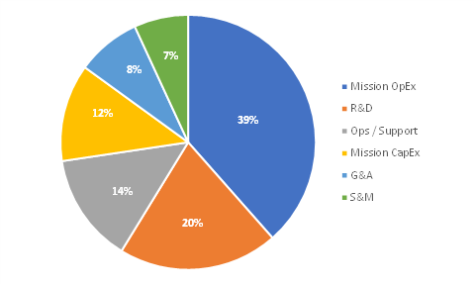
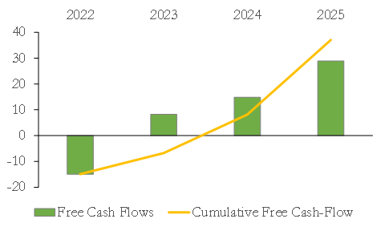
Financial Needs
20 M€
Use of Proceeds
Free Cash-Flow vision (in M€)
Notes:
Clear + reasonable financial needs to achieve roadmap

Slide 25
Appendices
Notes:
Clear + concise description of what this is about (e.g. 30s elevator pitch)vator pitch)

Slide 26
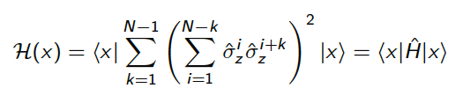
Solution - Quantum Computing
The space of radar design configurations is huge
From the work of Les Atomes de Savoie, Quantum Approximate Optimization Algorithm (QAOA) seems promising to solve this task for large N
This could increase the accuracy of radio detection by a factor of 10 allowing to discriminate and detect more precisely objects
Notes:
- Value proposition clearly + concisely stated (include ROI for user)
- Product/service clearly explained in practice + what it means for user (user journey)

Slide 27
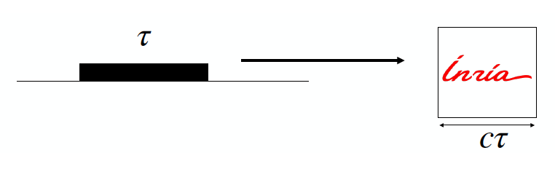
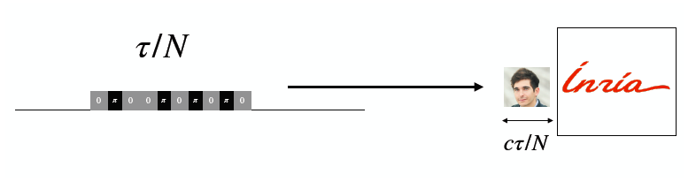
Problem - Waveform Optimization
Radar is a detection system that uses radio waves to determine the distance, velocity or angles of objects
These properties are determined through echo delay
To increase the precision of the measurement, the phase of the signal is modulated. What is the optimal waveform?
Notes:
- Problem clearly + concisely stated
- Critical pain point: people are actively looking for a solution

Slide 28
Business Plan

Slide 29
Sales pipeline

Slide 30
Technology stack

Slide 31
Integration/setup

